Slide 1
Innovative Model for Agriculture Rural Finance Istanbul 25 Nov. 2017
Nabil Ghalleb, CEO Zitouna Tamkeen

Slide 2
Summary
Zitouna Tamkeen
Economic Empowerment for Poverty Alleviation
Innovative Model for Agricultural Rural Finance

Slide 3
Zitouna Tamkeen
Economic empowerment for poverty alleviation
Innovation model for agricultural rural finance

Slide 4
Who We Are
Zitouna tamkeen is the first and unique Islamic microfinance institution in Tunisia and was created with the intention to institutionalize the economic empowerment financing approach by building a financial institution whose activity goes beyond financial inclusion and promotes vulnerable people empowerment and economic inclusion.
Zitouna Tamkeen adopts the economic empowerment financing model and uses the tools of Islamic microfinance. This approach combines innovation, resourcefulness and opportunity to address critical social challenges.

Slide 5
Vision & Mission
Mission
Participate in the economic inclusion of disadvantaged populations through Islamic microfinance and support self-employment projects and initiative
Vision
Become a key player in Islamic microfinance
sector at the national level and internationally

Slide 6
Capital Structure
A leading Islamic bank in Tunisia
Islamic Development Bank
A Specialized Microfinance Fund
A leading Islamic insurance company in Tunisia
POULINA Holding: a leading company in Tunisia
Délice Holding: a leading company in the dairy industry
The state investment fund

Slide 7
Partnerships and Networking
Institutional partnerships
Partnerships with some key players in the civil society and public sector
Advocacy and Training on Economic Empowerment and social finance
A variety of profiles
Associations
NGOs
Research institutions
Public sector
Business centres

Slide 8
How We Operate
NGO
MFI
Consulting Company
Establishment of an adequate environment for the EE Concept
Funding and follow-up
Design of investment projects within the framework of EE

Slide 9
Strategic Goals by 2020
Line of Finance
400 M TND over the 5 years
Footprint
40 branches across the country
Customers
65 000 clients
Staff
350 employees

Slide 10
Zitouna Tamkeen
Economic empowerment for poverty alleviation
Innovative Model for Agricultural Rural Finance

Slide 11
Economic Empowerment Definitions
Mayoux Definition - 2008
World Bank definition - Sourcebook on Empowerment (2002)
"The process through which those who are currently disadvantaged achieve equal rights, resources and power"
“The expansion of assets and capabilities of poor people to participate in, negotiate with, influence, control and hold responsible institutions that affect their lives”

Slide 12
Tackling multifaceted poverty
Economic empowerment of disadvantaged populations is only possible through the removal of 6 barriers
Appropriate funding
Access to market
Strengthening of technical and managerial capacities
Infrastructure and supportive investment
Intelligent partnerships
Investment opportunities
Putting the poor at the heart of our business model as key Business Partner

Slide 13
Tackling multifaceted poverty
The EE institution does not only measure its performance through financial indicators but most importantly through the social and economic impacts. These impacts on the marginalized social categories are monitored via several features that include:
Developing economic abilities so that they can manage their daily lives.
Enabling them to effectively participate in economic projects.
Enabling them to obtain resources and infrastructure necessary to navigate, produce and access new markets.
Enabling them to obtain and grow necessary financial resources.
Enabling them to obtain adequate income.
Providing them with support and mentoring to develop their ability to independently deal with administration and make appropriate economic decisions.
Enabling them to obtain the minimum necessary social services.

Slide 14
Leading Experiences
Economic Empowerment program in
Sudan
(100 M$ and 200k beneficiaries)
Economic Empowerment program in Palestine
(131 M$ and 10k beneficiaries)
Economic Empowerment program in Djibouti
(1,5 M$ and 1000 beneficiaries)
Economic Empowerment program in Benin
(11 M$ and 30k beneficiaries)

Slide 15
Economic empowerment project in Sudan
The Islamic Bank has set up an economic empowerment program of 65 Million Dollars.
The program mobilized an additional 136 M$, 12M$ were from the IDB, 20 M$ from the Zakat Fund and the rest from local banks.
172 000 poor people are economically enabled each year.
800 000 people make a living from this program.
13 financing formulas are used from which Murabaha represents 10%.
The program participated in resisting Inflation by products such as Musharaka and Salam.

Slide 16
Economic empowerment project in Palestine
The program started with 10 M$ and reached 131M$.
13 000 projects were founded and 26 000 jobs were created.
39 thousand families have improved their situations, 5 000 Family have overcome poverty.
270 000 people are supported by this program, 60% of them are children.
30 M$ are annually made.
The program rationalizes and maintains the Waqf property.

Slide 17
Economic empowerment project in Benin
The program started with 10 M$
Target as of today 95 k extremely poor beneficiary
Created 500 productive projects for less poor segment.
Increased families expenses by 81%.
Improved their health and food status by by 85% and 87% respectively
Improved their social and family situations by 87% and 88% respectively.
Reduced forced Migration

Slide 18
Zitouna Tamkeen Ecosystem
NGO
MFI
Consulting Company
Establishment of an adequate environment for the EE Concept
Funding and follow-up
Design of investment projects within the framework of EE

Slide 19
International Center for Economic Empowerment
Create business centers to train, reinforce and support entrepreneurs
6
1
Provide advice and specialized studies
Research and development in the field of economic empowerment and Islamic microfinance
5
TEXT
2
Establish institutions specialized in economic empowerment
Strengthen the capacity of institutions wishing to penetrate the Islamic microfinance sector and economic empowerment
Establish high-level international partnerships
4
3

Slide 20
Tamkeen For Development
1
A non-profit organization
2
Supports beneficiaries and prepare them for economic empowerment projects
3
Promotes economic empowerment ideas and projects
4
Directs public officials to improve the environment for initiative and investment
5
5
Provides an independent forum for bringing together and converging interests and promoting cooperation between different groups in society

Slide 21
Zitouna Tamkeen
Economic empowerment for poverty alleviation
Innovative Model for Agricultural Rural Finance

Slide 22
Poverty indicators in Tunisia
Poverty rates in Tunisia by region
Comments
While decreasing from the year 2000 to 2015, the poverty rate in Tunisia reached 15,2% in 2015
The poverty rate in Tunisia differs from one region to another. While the Grand Tunis region registers the lowest poverty rate with 5,3% followed by the North-East and Centre-East regions with respectively 11,6% and 11,5%, The North West and Centre West have the highest poverty rates with respectively 28,4% and 30,8%
Source: National Institute of Statistics

Slide 23
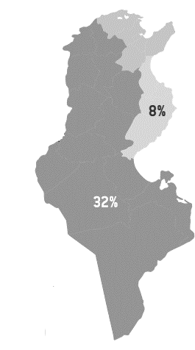
Poverty indicators in Tunisia
Poverty rates in Tunisia by governorate and region
Comments
The inequality among the Tunisian regions is more visible in the difference between the costal regions and interior regions. In fact the poverty rate in the interior regions is 4 times higher than the rate in the side regions.
Kairouane, Le Kef and Kasserine have the highest poverty rates respectively 34,9 34,2 and 32,8.
The maps show that the governorates with rural areas are the most suffering. In fact, statistics shows that the rates in communal areas are 10,1% while the non communal areas suffer from a 26% poverty rate.
This can be explained by the fact that 46% of smallholder farmers are illiterate.
Sources: Site de l’Institut Nationale de la statistique, “Référentiel Du Développement Agricole Durable En Tunisie » Published by Le Ministère de l’Agriculture, des Ressources Hydrauliques et de la Pêche et l’Agence de la Vulgarisation et de la Formation Agricoles (AVFA)

Slide 24
Economic empowerment to alleviate smallholder farmers’ challenges
Zitouna Tamkeen adopts the Economic Empowerment approach. An innovative approach to achieve high socio-economic impact. This approach is focused on value chain financing and targets especially agriculture value chains.
Objectives
Scan for high potential value chains in terms of job creation
Calibrate the intervention points to reach the greatest number of beneficiaries via the financing of Economic Empowerment projects.

Slide 25
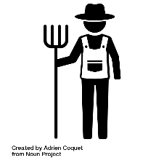
Economic empowerment to alleviate smallholder farmers’ challenges
Zitouna Tamkeen acts as a link between the upstream (Production) and the downstream (Marketing) in a Value Chain.
Production
Marketing
Distribution
Strategic partner
Smallholder farmer
(Upstream)
(Downstream)
End market
Financing Economic Empowerment and capacity building projects will strengthen the various links in the value chains and promote synergy between its various players.
A fundamental pillar of the Economic Empowerment approach is to ensure the sustainability of micro-projects and long term jobs in vulnerable sectors in the rural areas such as agriculture. Thus, Zitouna Tamkeen conducts strategic business models that will ultimately benefit future small farmers and agriculturists.

Slide 26
Zitouna Tamkeen Business Model
(5) Providing goods/services
Strategic partner
(6) Payment
(4) Assistance and follow up
(3) Coaching
(1) Smart partnerships for EE projects
Beneficiary
(7) Payment
(3) Financing
(2) Project study

Slide 27
Zitouna Tamkeen Business Model
Zitouna Tamkeen’s model includes five parties with complementary roles. The implementation of an economic empowerment project goes through 4 steps:
Elaborate Smart partnerships: With the help of a strategic partner, the ICEE can identify a shortage in the market from which we can add value through a value chain approach. Therefore, a financial and technical study is elaborated by the ICEE to verify the profitability of the project for all parties involved.
The Project study is then communicated to Zitouna Tamkeen which identifies its potential clients for financing,
Meanwhile, Tamkeen for development starts with the training of the beneficiaries of the project.
After training and financing, the beneficiaries start the production phase with a guaranteed market and the assistance and follow up provided by the strategic partner and Zitouna tamkeen, which guarantees a constant revenue for the beneficiaries and therefore the payment of the MFI.

Slide 28
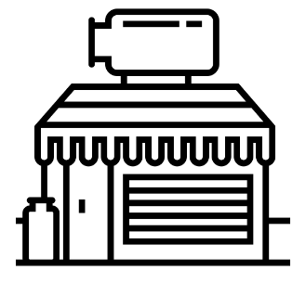
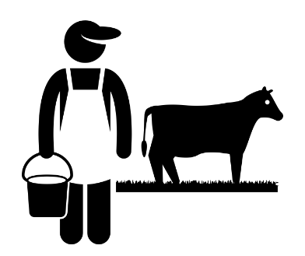
Case study: “Hlib El Khir” Project
Project presentation
(5) Milk selling
A major project in the North-western and Central regions of Tunisia.
(6) Collection sites reimbursement
(1) Strategic partnership
2500 small-scale breeders will benefit from the financing of purebred herds, milking equipment and secure an outlet for their production.
(7) Deduct installment on behalf of ZTM
(3) Financing
Project includes a training and technical assistance program provided by livestock advisers.
(4) Sell milk
(2) Coaching , assistance and follow up
(8) Payment
No branches required in execution areas and innovative guaranty system.

Slide 29
Impact of Hlib El Khir Project
Out of the project
Part of the project
Cattle size : 4 cows
Cattle size : 8 cows
Random Silage
Customized silage at the farm to reduce farmers operational costs
Random feeding
Carefully examined feeding (nature and quantities) adapted for the needs of the cattle
Average daily milk production: 9L/cow
Average daily milk production : 15L/cow
Average daily milk sales: 29 L
Average daily milk sales: 104 L
Average revenu: < 330 TND
Average revenu (5yrs) : 760 TND

Slide 30
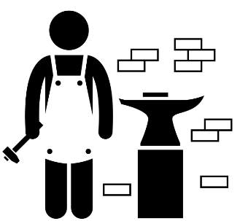
Always closer
Proximity to smallholder farmers
Financial institutions are usually located in urban areas, which creates an additional difficulty for small farmers and small business owners in the rural areas to access financial services
Remedy
Mobile Branches can help to create more proximity to small holder farmers and other small business owners wherever they are.

Slide 31
Further Innovations
Mobile financial services
Crowdfunding in microfinance
Mobile financial services in microfinance include:
Information
Funding pre applications
Payment
Crowdfunding platforms can:
Increase the capacity of financing of MFIs through funds raised by their clients on these platforms.
Provide a new source for funding for MFIs
Guaranty fund for small farmers
Mitigate default risk
Support Government strategy to develop the sector
Increase number of beneficiaries
Support assets growth over certain sectors

Slide 32
Thank you!

